Slide 1
Orange Juice Music App
Team Orange Juice (Jason Kauppila)

Slide 2
A Composer’s Struggle
Writer’s block
Lack of inspiration
Compositions lacking creativity
Songs sound like they were made from the same mold

Slide 3
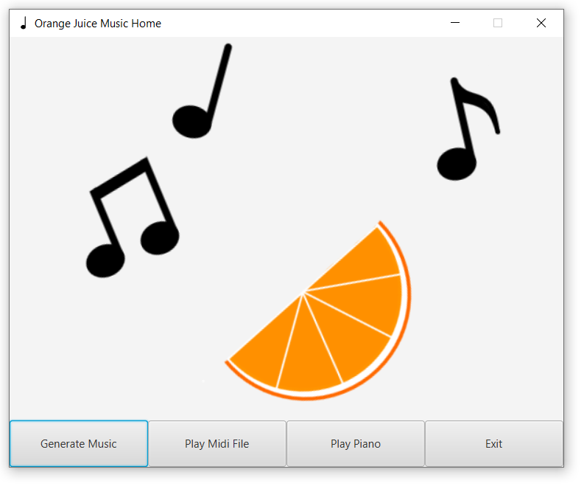
A Solution for a Composer’s Struggle
Orange Juice Music App
Tools to help inspire you all in one place

Slide 4
Orange Juice Music App
Has 3 main parts:
Orange Juice Midi Generator
Orange Juice Midi Player
Orange Juice Piano

Slide 5
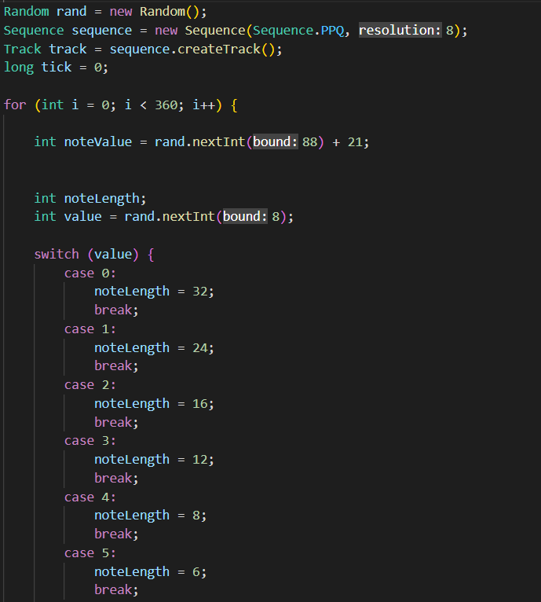
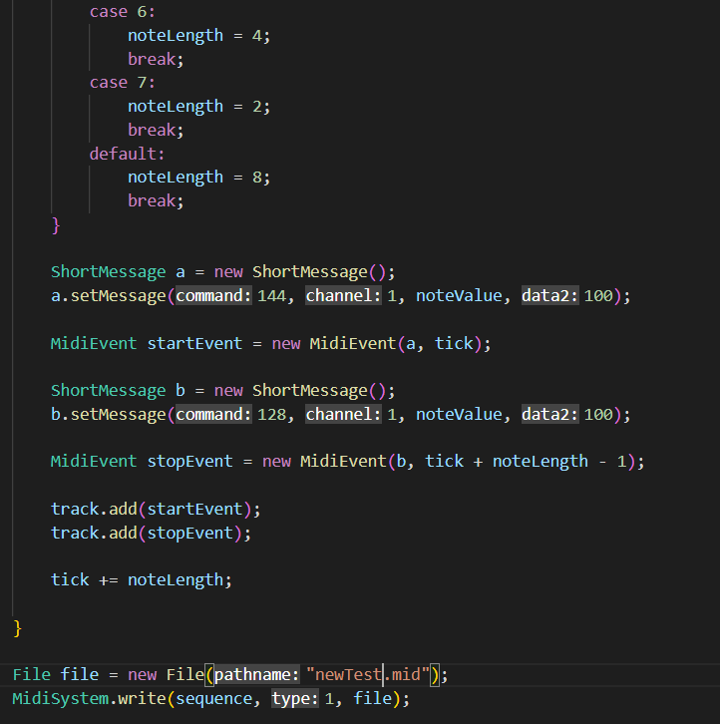
Typical Randomly Generated Midi Music
Some simple sample code to generate a random midi part for a piano:
Worse results could be generated if there were not fixed options for the note length.

Slide 6
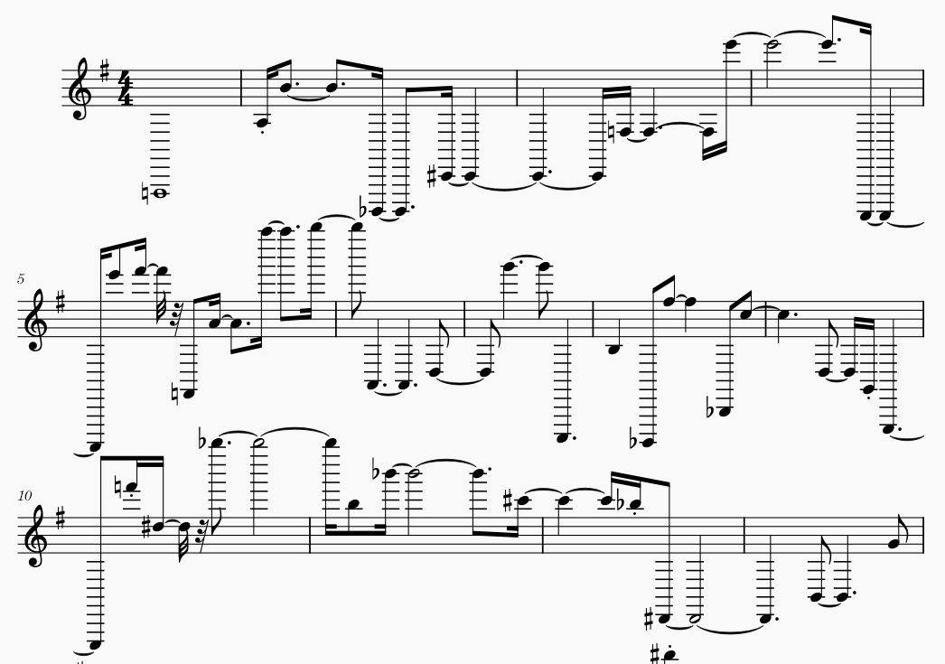
Typical Randomly Generated Midi Music

Slide 7
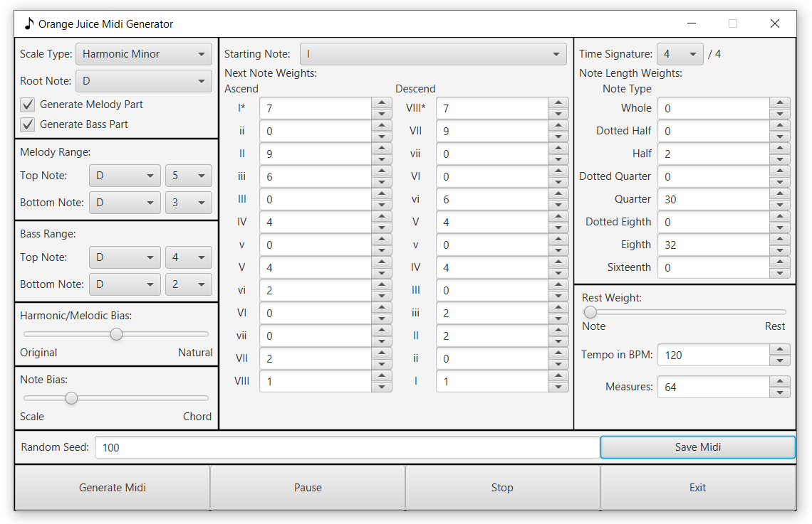
Orange Juice Midi Generator Music

Slide 8
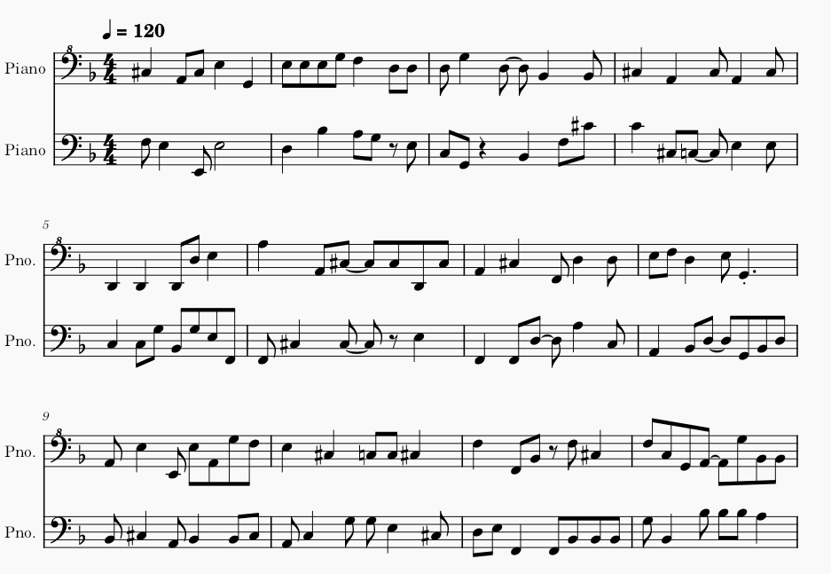
Orange Juice Midi Generator Music

Slide 9
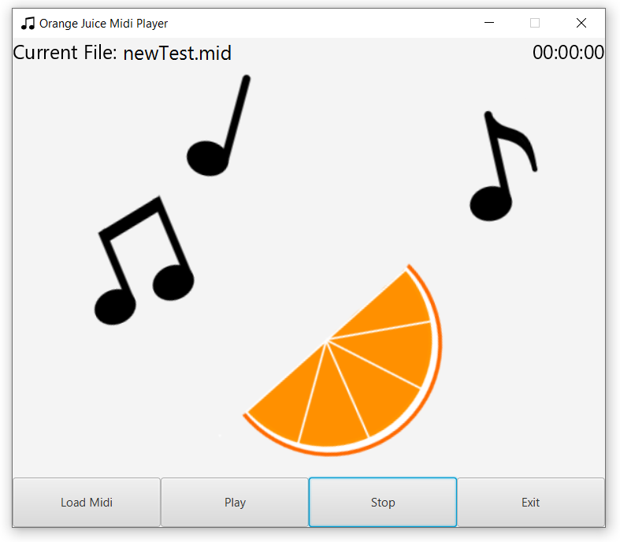
Orange Juice Midi Player
Can play a pre-existing midi file on you computer!

Slide 10
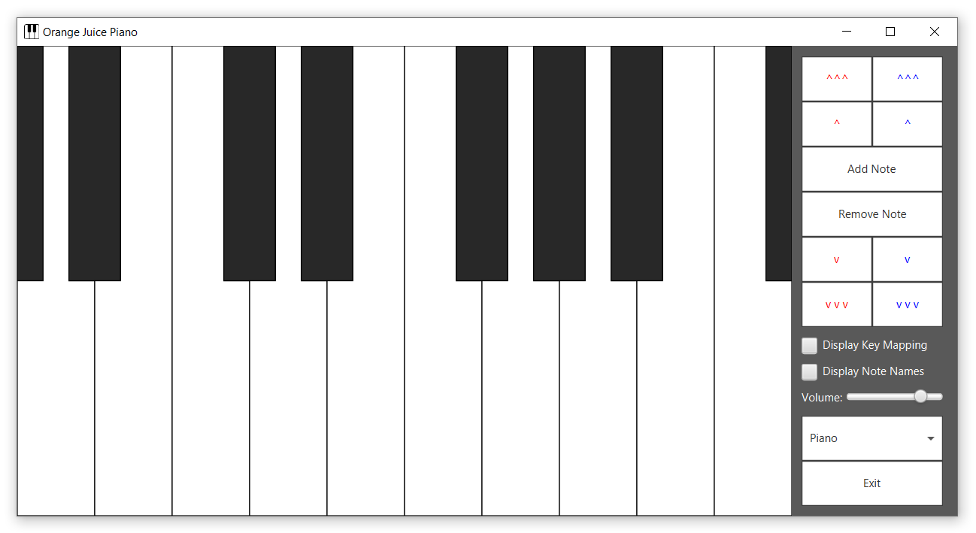
Orange Juice Piano
A virtual piano on your computer!
Can be played with either keyboard or mouse.

Slide 11
Orange Juice Music App UML Diagram

Slide 12
Quick Summary of UML Diagram
OrangeJuiceMusicApp holds MidiGeneratorPane, MidiPlayerPane, PianoScene
MidiGeneratorPane holds RangePane, ScaleWeightsPane, TimeWeightsPane and creates Song
ScaleWeightsPane holds NoteWeightsPane
NoteWeightsPane uses DefaultNoteWeights
Song holds Measure
Measure holds Note and contains TimeSignature and Chord
Note uses NoteUtil
PianoScene holds PianoPane
PianoPane holds KeyboardPane
KeyboardPane holds subclasses of the abstract class PianoKey
StandardKey, B_E_Key, C_F_Key, FinalCKey, SharpFlatKey, FinalSharpFlatKey

Slide 13
The Building Process of Orange Juice Music App
All the work was done by the sole team member of Team Orange Juice.
This includes the artwork (please note that this team member is more of a musician than an artist.)
The virtual piano was designed first.
First the KeyboardPane was designed, then the PianoPane with buttons, and finally the PianoScene.
A lot of time was spent debugging this
The midi player was designed second.
The midi generator was designed third using some of what was learned from the midi player.

Slide 14
What I Have Learned
The format of some midi data
Start and stop note messages
Tempo and time signature messages
How to create midi events in Java and use them in meaningful ways
Getting customizable input can sometimes be more troublesome than the logic behind using that input
Setting default settings can take a long time

Slide 15
Orange Juice Music App Demo

